Slide 1
UNIT - IV
Artificial Intelligence

Slide 2
Intelligence - the ability to acquire and apply knowledge and skills.
Artificial intelligence - refers to the simulation of human intelligence in machines that are programmed to think like humans and mimic their actions.
cognitive science - the study of thought, learning, and mental organization, which draws on aspects of psychology, linguistics, philosophy, and computer modelling.

Slide 3
Types of Intelligence
Linguistic Intelligence - greater ability to express themselves well both verbally and in writing
Logic Intelligence - the ability to manage Math and logic with ease
Kinaesthetic Intelligence - great sense of space, distance, depth and size. relates to the ease of bodily expression
Spatial Intelligence - ability to create, imagine and draw 2D and 3D images
Musical Intelligence - ability to listen to sound and music and identify different patterns and notes with ease
Interpersonal Intelligence - people with a great sense of responsibility towards others. Influence people
Intrapersonal Intelligence - deeply connected with themselves.

Slide 4
1. Approaches to Knowledge Representation (KR)
AI programs use structures (knowledge structures) to represent objects, facts, relationships, and procedures
Knowledge structures provide expertise and information so that a program can operate in an intelligent way
KSs are usually composed of traditional and complex structures like semantic network, frames, scripts, conceptual dependency, etc.

Slide 5
A knowledge base is a special type of function of DB that holds knowledge of the domain
Knowledge bases share some of the functions such as storing, updating, retrieving info.
They are much powerful and more structured
Following are the knowledge representation schemes
Relational knowledge
Knowledge represented as logic
Procedural knowledge

Slide 6
1.1 Relational knowledge
This comprises objects consisting of attributes and associated values
Simplest way of storing facts is to use a relational method
A table is defined as a set of data values using rows and columns
Columns are attributes & rows are corresponding values of attributes

Slide 7
Name | Age (in years) | Gender | Qualification | Salary (in Rs.)
John | 38 | M | Graduate | 20000
Mike | 25 | M | Undergraduate | 15000
Mary | 30 | F | Doctorate | 50000
James | 29 | M | Graduate | 20000
This representation helps in storing the facts but gives little inference
It is easy to obtain to answers of the following queries
What is the age of John
How much does Mary earn
What is the qualification of Mike
But we cannot obtain answers for the questions like “Does a doctorate earn more?”
So, inferencing new knowledge from structures is not
possible

Slide 8
1.2 Knowledge represented as logic
Inferential capacity can be achieved if knowledge is represented in the form of formal logic
E.g. knowledge about mortality “all humans are mortal” cannot be represented using relational approach
It can easily be represented in predicate logic
– (ꓯX)human(X)<-mortal(X)
Advantages: a set of rules can be represented, derived more facts, truths and verified the correctness of new statements

Slide 9
1.3 Procedural knowledge
This is encoded in the form of procedures which carry out specific tasks
E.g. an interpreter interprets the program on the basis of available knowledge regarding the syntax and semantics of the language
Advantages: domain specific knowledge can be easily represented and side affects can be easily modelled
Disadvantage: problem in completeness
(all cases may not be represented) and consistency(all deductions may not be correct).

Slide 10
2. KR using semantic network
Basic idea is, the meaning of the concept is derived from its relationship and other concepts
The information is stored by interconnecting nodes with labelled arcs
E.g. every human, animal and birds are living things who can breathe and eat. All birds can fly. Every man and woman are human who have two legs. A cat has fur and is an animal. All animals have skin and can move. A giraffe is an animal and has long legs and is tall. A parrot is a bird and is green in colour. John is a man.

Slide 11
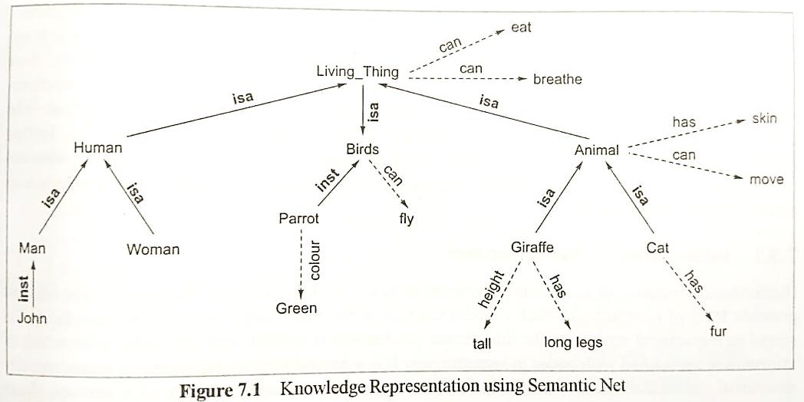

Slide 12
isa – relation connects two classes where one concept is a kind or subclass
inst- relation relates specific members of a class, such as John is an instance of Man
Other relations such as {can, has, colour, height} are known as property relations
These are represented in dotted lines pointing from the concept to property
In this structure, property inheritance is easily achieved
E.g. the query “does a parrot breathe?” can be easily answered as ‘yes’

Slide 13
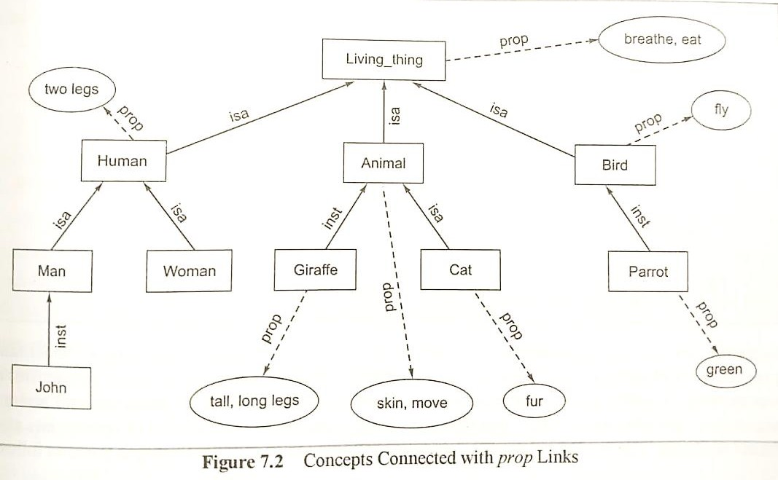

Slide 14
Isa and inst links have well-defined meaning
Semantic net interpreter cannot understand all the attribute links unless their semantics are encoded into it
The interpretation of a prop link can be the property of the class
The information encoded can be represented as a digraph as in fig. 7.2
The square nodes represent concepts or objects connected with isa or inst links
Oval nodes represent property attributes attached to the square nodes

Slide 15
2.1 Inheritance in semantic net
Hierarchical structure of KR allows knowledge to be stored at the highest possible level of abstraction
This reduces the size of the knowledge base
Semantic net is stored as hierarchical structure hence, inheritance mechanism is in-built
It helps in maintaining consistency of knowledge base by adding new concepts and members to existing ones
The algorithm to retrieve a property of an object is as follows

Slide 16
Algorithm: Property Inheritance Algorithm
Input: Object and property to be found from Semantic Net
Output: returns ‘Yes’, if object has the desired property else returns ‘No’
Procedure:
Find an object in the semantic net
Found = false
While [(object!= root) or found] Do
{
If there is an attribute attached with object then found = true
Else {Object = isa(object, class) or object = inst(object, class)}
}
If found = true then report ‘yes’ else report ‘no’

Slide 17
3. Extended Semantic N/Ws for KR
Simple semantic n/w is represented as a digraph whose nodes represent concepts/objects & arcs represents relations between concepts/objects
An alternative way of representing semantic net in detail with more semantic links is Extended Semantic N/Ws
The English sentences “John gives an apple to Mike and John and Mike are Human” may be represented in semantic n/w as follows

Slide 18
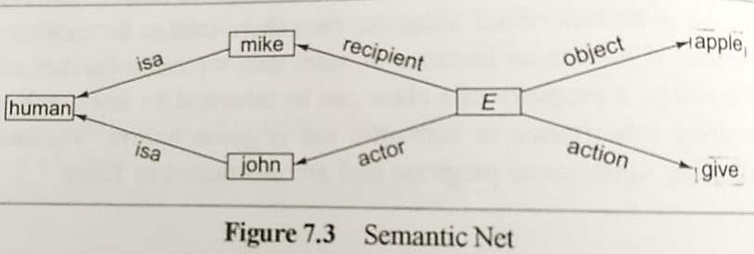
Here E represents an Event which is an act of giving, whose actor is John, the object is an apple, and recipient is Mike
Semantic net can hold semantic information about situation such as actor of an event giving is john and object is apple
In the sentence, John gives an apple to Mike

Slide 19
The relations of the network can be expressed in Clausal form of logic as follows:
Object(E, Apple)
Action(E, Give)
Actor(E, John)
Recipient(E, Mike)
isa(John, human)
isa(Mike, human)
Predicate relations of labels on the arcs of semantic n/ws always have two arguments
Hence the entire semantic net can be coded using binary representation (two argument reptn.)

Slide 20
Such representation is advantageous when additional information is added to the system
E.g. John gave an apple to Mike in the kitchen, it is easy to add location(E, kitchen) to the set of above facts
In First Order Predicate Logic, predicate relation can have ‘n’ arguments, where n>=1
E.g. John gives an apple to Mike is represented in predicate logic by give(John, Mike, apple)
Here John, Mike and apple are arguments, give represents a predicate relation

Slide 21
Predicate logic representation has greater advantages compared to semantic net
E.g. John gives an apple to everyone he likes
The sentence is expressed in predicate logic by the clause as
give(John, X, apple) <- likes(John, X)
here the symbol X is a variable representing any individual
here left side of ‘<-’ contains conclusions, while right side of ‘<-’ contains conditions

Slide 22
Disadvantage: it is not convenient to add new
information in an n-ary representation
E.g. if we have 3-ary relation, give(John, Mike, apple) representing ‘John gives an apple to Mike’
– To capture new information about kitchen in the sentence ‘John gave an apple to Mike in kitchen’, give(John, Mike, apple, kitchen)

Slide 23
A clause in logic can have several conditions, all of which must hold for the conclusion to be true and can have several alternative conclusions, at least one of which must hold if all the conditions are true
E.g. if John gives something he likes to a person, then he also likes that person
– This is represented as
likes(John, X) <- give (John, X, Y), likes(John, Y)

Slide 24
In conventional semantic n/w, we cannot express clausal form of logic
It can be surpassed by Extended Semantic N/w (ESNet), that combines the advantages of both Logic and Semantic
ESNet can be interpreted as
a variant syntax for the clausal form of logic,
It has the same expressive as that of predicate logic with well-defined semantics, inference rules
A procedural interpretation
Also incorporates the advantages of using binary relation as a semantic n/w rather than n-ary relations of logic

Slide 25
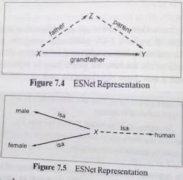

Slide 26
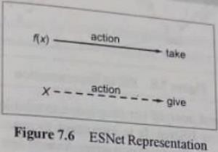
3.1 Inference rules
Some of the rules are
– The representation of the inference for every action of giving, there is an action of taking in clausal logic action(f(x), take)<-action(x, give)
Dr. T. K. Rao - VVIT 24

Slide 27
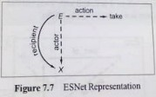
– The inference rule that an actor performs a taking action is also the recipient of this action and can be easily represented in clausal logic
Recipient(E,X)<- action(E, take), actor (E, X)
25

Slide 28
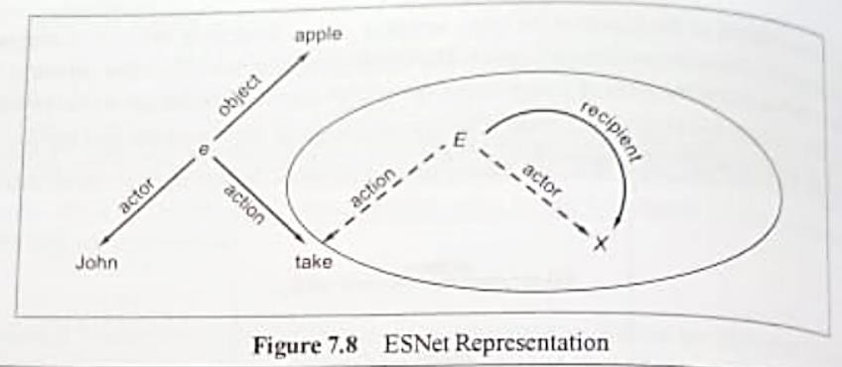
E.g. Represent the following clauses in ESNet Recipient (E, X) <- action (E, take), actor(E, X) Object(e, apple)
Action (e, take) Actor (e, John)
Dr. T. K. Rao - VVIT 26

Slide 29
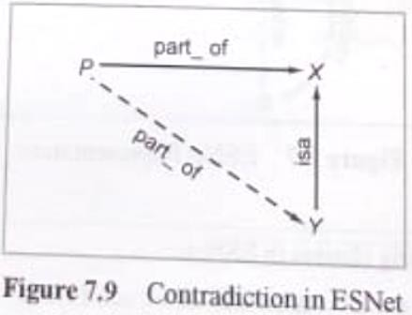
the hierarchy links isa, inst and part_of (or prop) are available in semantic n/ws also as special cases in ESNet
Here P part_of X is conclusion and P part_of Y is condition, where Y is linked with X via isa link
Dr. T. K. Rao - VVIT 27

Slide 30
3.2 Deduction in ESNets
In logic there are two types of mechanisms
Forward reasoning inference mechanism (also called bottom-up approach)
Backward reasoning inference mechanism (also called top-down approach)

Slide 31
Forward reasoning inference mechanism
Given an ESNet, apply the following reduction using Modus Ponen rule of logic (i.e., given (A<-B) and B, then conclude A)
E.g. isa(X, human) <- isa(X, man) isa (John, man)
Using Modus Ponen rule of logic,
isa(John, human) become true

Slide 32
Forward reasoning inference
Given set of clauses Isa(X, human) ← Isa(X, man) Isa(john, man). | Inferencing Isa(john, human)
human Isa X Isa man john Isa Here X is bound to john | human Isa john

Slide 33
Backward reasoning inference mechanism
In this, a conclusion or goal can be proved from a given ESNet by adding the denial of the conclusion to the n/w and show that the resulting set of clauses in the n/w gives contradiction
We need to prove isa(John, human) using the same network

Slide 34
Backward reasoning inference
Given set of clauses Prove conclusion
Isa(X, human) ← Isa(X, man) Query: Isa(john, human) Isa(john, man).
denial of query
human
human
Isa john
Isa
Isa
X
X
Isa
Isa
man
man
john Isa
Isa

Slide 35
4. KR using Frames
Frames are an extension to semantic nets
Each node of a semantic net is represented by a Frame, which can be defined as a DS
It consists of collection of attributes or slots and associated values that describe real-world entity
Frames are slightly similar to the O-O paradigm
Frames consists of attributes or slots, which are described with attribute-value pairs
<slot_name, value>

Slide 36
Slots are complex structures in general, that have facets (or fillers)
describing their properties
Value of a slot is text, integer, constant or it may be another frame
So slots may contain value, refer to other frames or methods
Each slot may contain one or more facets (called fillers) which may take many forms such as:
value (value of the slot),
default (default value of the slot),
range (indicates the range of integer or enumerated values, a
slot can have),
demons (procedural attachments such as if_needed, if_deleted, if_added etc.) and
other (may contain rules, other frames, semantic net or any
type of other information).

Slide 37
Structure of a frame
Frame name
Slot-filler
Default values
Constraints on values within the slots of a frame
Pointers (links) to other frames
Ako (a-kind-of or subclass)
Inst (instance)
Instantiation procedure
Inheritance procedure
Default inference procedure
Triggers

Slide 38
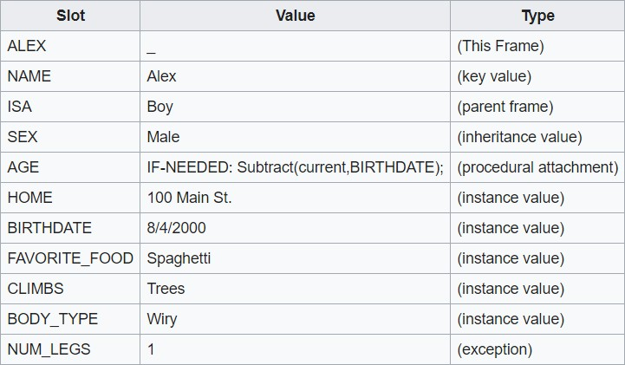

Slide 39
university
a_part_of
department
a_part_of
faculty
hostel
is_a nilgiri hostel
ako
science_faculty
is_a
renuka
A simple frame system

Slide 40
Detailed Representation of Frame Network
frame0
f_name: university
phone: (default: - 011686971)
address : (default - IIT Delhi)
frame1
frame2
f_name : department
a_part_of : frame0
programme : [Btech, Mtech, Ph.D]
f_name : hostel
a_part_of : frame0
room : (default - 100)
frame11
f_name: faculty a_part_of : frame1 age : range (25 - 60) nationality: (default - Indian) qual: (default - Post graduate)
frame21
f_name : nilgiri is_a : frame2 phone : 0116862345
frame12
f_name : science faculty ako : frame11 qual : (default - M.Sc)
frame13
 | f_name : renuka
 | is_a : frame12
 | qual : Ph.D
 | age: 45
 | adrress: Janak Puri
40

Slide 41
A frame can be an instance of some frame and a part of another frame, hence it can have both Inst and Part_of links
A frame can be a_kind_of frame of one frame and apart of another frame, hence, it can have AKO and Part_of links
It is not possible to have a frame which is both an instance and a_kind_of some class at the same time, hence the links Inst and AKO in a frame are not possible

Slide 42
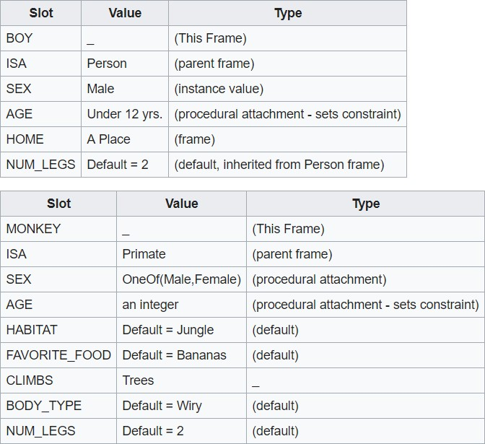

Slide 43
Frame contains information on how to use frame, what to expect next, & what if expectations are not met
A frame's terminals are already filled with default values, which is based on how the human mind works
Strength of frame based KR is that, unlike semantic networks, they allow exceptions in particular instances
This gives frames an amount of flexibility that allow representations of real world phenomena to be reflected more accurately

Slide 44
4.1 Inheritance in frames
Inheritance is a mechanism which is utilized for passing knowledge from one frame another
It is a good way of obtaining information that is not stored in the place we first looked
It leads to cognitive economy, where info. is stored at one place, while it can be retrieved from different parts of the n/w

Slide 45
Attachment of Demons
Demons allow us to invoke rules within the frames and are considered to be a powerful style of programming
These can be attached with a slot along with other required facets
E.g. A demon if_added may be used to validate data when added in the value slot
– If value slot is to be entered for a patient of child hospital, it will check whether it is in the specified range or not

Slide 46
5. Conceptual Dependency Theory
Conceptual Dependency (CD) theory is used for natural language understanding
It focuses on the concept and meaning rather than on syntax and structure
CD uses the basic hypothesis that the ACTION is the basis of any proposition
Propositions that describe events are made up of conceptualizations that include an actor, an action & few cases that depends on the action

Slide 47
Similarities and overlapping in meanings are handled by the concept PRIMITIVE ACTION
The primitives are the elements that can be used in varied combinations to express the underlying meaning of the given word
CD uses 11 primitive acts, proposed by Schank
The structural similarities in the sentence represented in actor-action-object framework

Slide 48
5.1 Conceptual Primitive Actions
Actions in natural language are generally specified by the verbs
Most of the verbs are categorized under the following eleven primitive actions
Sometimes one verb may fall into two categories
Then the most relevant in the context might be chosen for interpreting the sentences
The PRIMITIVE ACTIONS are as follows:

Slide 49
ATRANS
PTRANS
PROPEL
MOVE
GRASP
INGEST
MTRANS
MBUILD
EXPEL 10.SPEAK 11.ATTEND

Slide 50
ATRANS: Transfer of an abstract relationship such as possession, control, or ownership, e.g. give, take, buy, etc.
It requires an actor, object and recipient
PTRANS: Transfer of the physical location of an object or actor that requires an actor, object, and direction, e.g. go, walk, fly, etc.
PROPEL: Application of physical force to an object, i.e. push, pull etc.
MOVE: Movement of a body part by its owner, e.g. kick, throw, hit
GRASP: Grasping of an object by an actor, e.g. catch, clutch, etc.
INGEST: Ingesting of an object by an animal, e.g. eat, drink, smoke, etc.
MTRANS: Transfer of mental information between animals or within an
animal itself, e.g. read, tell, speak, sing, etc.

Slide 51
MBUILD: The construction of new information from old information within actor, i.e. to create or combine thoughts internally, e.g. decide, describe, imagine, consider, answer, etc.
EXPEL: Expulsion of something from the body of an animal, e.g. weep(expel tears), cry(expel tears), swear(expel moisture), etc.
SPEAK: Producing sounds, e.g. say, tell, sing, etc.
ATTEND: Focusing of a sense organ toward a stimulus,
e.g. listen, watch, see, look etc.

Slide 52
Grouping of Primitives
Category | Primitive Acts
State Change | ATRANS,PTRANS
Mental Action | MTRANS,MBUILD
Senses | ATTEND,SPEAK
Physical Action | INGEST,MOVE,GRASP,PROPEL,EXPEL

Slide 53
5.2. Conceptual Category
CD provides a specific set of building blocks from which representations can be made rather than only a structure in which a knowledge can be represented.
There are four primitive conceptual categories from which dependency structures can be built
ACT: Actions {one of the CD primitives representing verb}
PP: Objects {pictures producers or noun/pronoun}
AA: Modifiers of actions {action aiders or adverb}
PA: Modifiers of PPs {picture aiders or adjective}

Slide 54
The relationships between concepts are called dependencies
The main conceptualization of a clause is a two-way dependency b/w a PP & an action
Actions are broken down into sequence of primitive ACTs
E.g. the CD representation for sentences such as “I took a book from the man”, “The man gave me a book”, “The book was given by a man to me” having the same meaning

Slide 55



p
o
r
I(to)
I
ATRANS
book
man(from)
Here
o – for the object case relation
r – for the recipient case relation
d – destination
Few other conceptual tenses are
P- past
F-future
T-transaction
ts - start transaction
Tf – finish transaction
K – continuing
C - conditional

Slide 56
5.3. Rules for Conceptualization Blocks in CD
The dependencies among conceptualisation correspond to semantic relations
Following is the list of the most important structures or rules:
– Rule1: relation b/w an actor and event caused by him is called a two-way dependency, as neither actor not event can be considered primary

Slide 57
Rule 1: PP ⬄ ACT
Examples | CD Representation
John ran | p John ⬄ PTRANS
Mary cried | p Mary ⬄ EXPEL
Rule 2: Rule representing relation b/w an ACT and the PP (object) of the ACT is shown by the direction of an arrow toward the ACT, since the context of the specific ACT determines the meaning of the object relation
Rule 2: ACT ← PP
Examples | CD Representation
John gave a book to Mary | John ⬄ PTRANS ←book
Mary kicked the ball | Mary ⬄ MOVE ← ball

Slide 58
– Rule 3: This rule shows relation both ways b/w two PPs,
one belong to the set defined by the other PP
Rule 3: PP ⬄ PP
Examples | CD Representation
John is a doctor | John ⬄ doctor
Mary is a teacher | Mary ⬄ teacher
– Rule 4: It shows a relation b/w two PPs, one of the PP provides a particular kind of information abou the other PP
Rule 4: PP ← PP
Examples | CD Representation
John’s car | Car | poss-by ← | John
Mary is in Delhi | Delhi | loc ← | Mary
Dr. T. K. Rao -
VVIT

Slide 59
– Rule 5: It shows a relation b/w a PP and a PA that is asserted to describe it
Rule 5: PP ⬄ PA
Examples | CD Representation
John is fat | John ⬄ weight (>50)
Mary is poor | Mary ⬄ income (<200)
– Rule 6: It shows a relation b/w a PP and an attribute that already has been prediction of it
Rule 6: PP ⬄ PA
Examples | CD Representation
Smart John | John ← smart
Charming Mary | Mary ← charming
Dr. T. K. Rao
- VVIT

Slide 60



– Rule 7: it shows a relation b/w an ACT and its physical source and destination locations of ACT
_{d} PP (destination) Rule 7: ACT PP (source)
Examples | CD Representation
John went to school from home | p John ⬄ PTRANS | d | School Home
Mary travelled from Delhi to Bombay by train | p Mary ⬄ PTRANS v train | d | Bombay Delhi

Slide 61
– Rule 8: it shows a relation b/w an ACT and its source and the recipient of ACT
_{r} PP (to) Rule 7: ACT PP (from)
Examples | CD Representation
John gave a book to Mary | p o r John ⬄ ATRANS ← book |  | Mary John
Mary told story to John | p o Mary ⬄ MTRANS ← book | r | John Mary

Slide 62


– Rule 9: It shows a relation b/w an ACT and the instrument using which it is performed
i Rule 9: ACT ← detailed conceptualization for instrumental
Ex: Mike ate custard with spoon
CD representation Simple form Detailed form
p i Mike ⬄ INGEST ← spoon o custard | p i Mary Mike ⬄ INGEST ← _{o} o Do ← spoon custard

Slide 63
– Rule 10: it shows a relationship that describes the change in state between PP and a state in which it started and another state in which it ended
PA Rule 10: PP PPA
Examples | CD Representation
The tree grow | Trees |  | Size>C Size=C
John is sick | John |  | Health(<normal) Health(=normal)

Slide 64
6. Case Grammars
Charles J. Fillmore proposed the Case Grammar theory in 1968
Introduced 6 cases (thematic cases or roles):
Agentive (subject)
Objective (object)
Instrumental (instrument)
Dative (covers experiencer)
Factive (covers result of an action)
Locative (location of action)

Slide 65
Agent (instigator of action):
Noun phrase of the sentence, the instigator of the action
E.g. John was given a book, here John is not agent, it may be dative of beneficiary
Object (identity on which action is performed):
The noun being acted upon by action
E.g. John broke the door, here door is object
Dative (animate entity affected by the action):
Refers to object of an action that is animate
E.g. John killed Mike, here Mike is dative case

Slide 66
Experiencer (animate subject in an active sentence with no agent):
For the sentence which have intransitive verbs, the subject become experiencer
E.g. John cried, here John is experiencer
Beneficiary (animate who was benefited by action):
It is an animate person for whom an action is performed
E.g. I gave an apple to mike, here Mike is beneficiary

Slide 67
Locative (place of action):
It can be enhanced to Source_location, Destination_location, etc.
E.g. John went to school, location case is school
Instrument (entity used for performing action):
If some instrument is used to perform an action, then it fills the instrument case
E.g. John ate an apple with fork, here fork is instrument
Co-Agent:
If two people perform some action together, the second person fills the Co-agent case
E.g. John and Mike lifted the box, here Mike is co-agent

Slide 68
Time:
This case basically contains the time when the action was performed
E.g. John went to market yesterday morning, here yesterday and morning are time case
Tense (tense of event):
Present, past, future of the sentence can be stored in order to generate surface structure sentence
E.g. I’m going to school, here present continuous is the
tense case
Designing grammar describe the relation b/w verbs and their arguments is the main focus in generating case frame

Slide 69
The mandatory fields are mentioned in Lexicon, whereas optional entries are represented by three dots
Verb lexicon for case grammar
Eat [Agent, Object, (prop - eatable), …]
Give [Agent, Object, Beneficiary, …]
Run [Agent, …]
Want [Agent, Object, ..]
Kill [Agent, Dative, …]
The verb eat requires mandatory thematic cases as Agent, Object that is eatable
It may have optional cases such as instrument, location time, etc.

Slide 70
Cases are associated with questions about the action and Case Frame is as follows
E.g. John gave an apple to Mike in the kitchen
Case | ← | Question | Answer
Action | ← | What was the event | Gave
Agent | ← | Who did the action | John
Objective | ← | What was involved in the event | Apple
Beneficiary | ← | Whom was it done/ who was beneficiary | Mike
Time | ← | When was the event done | Past
Location | ← | Where was the event done | Kitchen

Slide 71
Examples of syntactically same but semantically different statements
Mike saw the girl in the garden with a telescope
Mike saw the girl in the garden with a cat
Mike saw the girl in the garden with a fountain
There are two levels of every sentence structure:
Surface structure: a spoken/ written sentence
Deep structure: gives underlying meaning of the sentence

Slide 72
7. Semantic Web (SW)
It is an extension of web that provides a common framework, which allows data to be shared and reused across different applications
SW meaning or semantics to web content to make it easier to be used
SW have data & documents so that machines can process, transform, assemble, and even act on data in useful ways
SW comprises XML, XML Schema, RDF, RDF Schema, and Web Ontology Language (OWL)

Slide 73
EXtensible Markup Language (XML):
A general purpose specification for creating custom markup languages, like HTML
XML tags are not predefined and user may define his own tags
It is self-descriptive, Its primary purpose is to facilitate the sharing of structured data across different systems
XML was designed to carry data across different information systems, not to display data as in HTML

Slide 74
XML representation
<circular>
<to> faculty </to>
<from> HoD </from>
<heading> Faculty Meeting </heading>
<body> There is a meeting of the faculty in committee room today at 2 p.m </body>
</circular>

Slide 75
XML Schema:
It is a language for describing the structure of an XML document, typically expressed in terms of constraints on the structure and content of docs.
They provide means for defining the structure, content and semantics of XML docs. in more detail
Purpose of XML schema is to define the valid building blocks of an XML document and that consists the following:
Elements and attributes that can appear in a document
Whether an element is empty or can include text
Data types for elements and attributes with default and fixed
values for elements and attributes

Slide 76
Typical XML Schema:
<xs:schema xmlns:xs= http://www.w3.org/2001/XMLSchema>
</xs:schema>
<xs:element name = “title” type= “xs:string”/>
<xs:element name = “author” type= “xs:string”/>
…
…
…

Slide 77
7.1. Resource Description Framework
The basic data model used to build the SW is called RDF, a domain-independent model for describing resources
A resource may be name, place, constant, web pages (URLs), parts of web pages, etc.
RDF uses URIs to represent data usually in triple structures
<subject, relation, object>
it make statements about web resources as subject- predicate-object expressions, called triples

Slide 78
Suppose a webpage http://www.cs.univ.ac.in has been created by Criss, then RDF terms for the various parts of the statement are:
The subject is the URL: http://www.cs.univ.ac.in
The predicate is the word “creator”
The object is the phrase “Criss”
Corresponding RDF statement is as follows:
<http://www.cs.univ.ac.in/~criss> <rel: creator> <“Criss”>

